Slide 1

Applied Data Science Capstone Project
The Third Place
"Most needed are those 'third places' which lend a public balance to the increased privatization of home life. Third places are nothing more than informal public gathering places.
- Ray Oldenburg, Ph.D., noted urban sociologist, author of “Celebrating the Third Place” and “The Great Good Place”, and originator of the Third Place concept.

Slide 2
Table of Contents
Introduction and Background
Project Objective
Data
Methodology
Results
Conclusions

Slide 3
Introduction and Background
“Third places host the regular, voluntary, informal, and happily anticipated gatherings of individuals beyond the realms of home and work. ... beer gardens, main streets, pubs, cafés, coffeehouses, post offices, and other third places are the heart of a community's social vitality.”
- Ray Oldenburg

Slide 4
Introduction and Background
Ray Oldenburg, urban sociologist, first coined the term “Third Place” in 1991, to reference social environments that are distinct from an individual’s home (“First Place”) and work environment (“Second Place”). Third places are where people congregate and interact other than work or home.
It has been noted that England has pubs, France has cafés, and Austria has coffee houses. In the past in the U.S., common third places included country stores, post offices, barber shops, hair salons, soda shops, and taverns.
Examples of Third Places in the U.S. today are:
Cafes, restaurants, pubs, coffee houses - Churches
Parks and other outdoor recreational areas - Schools, Libraries
Indoor recreational areas such as arcades - Social and community centers

Slide 5
Introduction and Background
But not all public venues are automatically considered a true Third Place. Characteristics of a Third Place are:
  Neutral space – no economic or social status prerequisites for participation
  Accessibility – are inclusive, and readily assessable
  Accommodating – provide for the needs of participants
  Regulars – regular occupants or participants who set the mood and characteristics of the venue
  Low Profile – not extravagant or pretentious, but accepting and inclusive
  Conversation – is the primary activity, although not necessarily the only activity
  Atmosphere – typically exhibit home-like warmth, acceptance and belonging

Slide 6
Introduction and Background
Sociologists propose that Third Places are critical for active civic engagement and effective democratic governance, and function as anchors of community life by facilitating positive social interactions and a “sense of belonging”. A shared sense of pride, commitment, and well-being are critical for strong and vibrant communities.
The Third Place concept has been widely embraced and developed since it’s introduction by business, academia, local governance, urban planners, architects and designers, and social policy advocates.

Slide 7
Project Objectives
"Life without community has produced, for many, a life style consisting mainly of a home-to-work-and-back-again shuttle.
- Ray Oldenburg

Slide 8
Problem Statement and Objective
Problem Statement
Attempts to quantify Life Satisfaction or Quality of Life often consider only Income or Economic related metrics, and fail to consider broader and more subjective metrics such as community involvement, sense of belonging and well-being – all attributes engendered by Third Places.
Objective
This analysis proposes to use Foursquare data on public and social venues (potential Third Places) for New York City communities to determine correlation to more conventional measures of Life Quality or Satisfaction.
Insights developed by this type of analysis could provide additional depth to assessments of “well-being”, and identify opportunities for businesses, communities, and policy makers in efforts to enhance community quality of life.

Slide 9
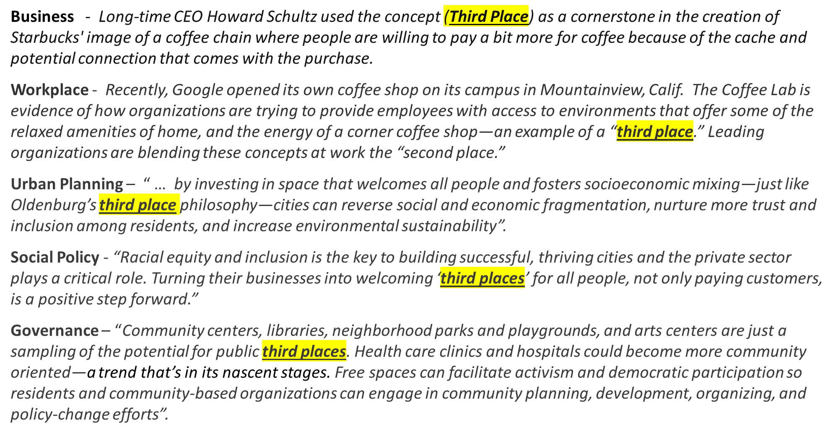
Value Proposition
The value of increased understanding of The Third Place dynamic extends to individuals, communities, business, governance, and social policy makers, as noted in the following quotes -

Slide 10
Data Acquisition and Processing
"What suburbia cries for are the means for people to gather easily, inexpensively, regularly, and pleasurably -- a 'place on the corner,' real life alternatives to television, easy escapes from the cabin fever of marriage and family life that do not necessitate getting into an automobile
- Ray Oldenburg

Slide 11
Data
For this project, the primary data sets are as follows:
  Foursquare
    Trending public venue data by category and grouped by New York City (NYC) neighborhood
  U.S. Census - Community Survey Data for Public Use Microdata Areas (PUMA)
  Selected Life Satisfaction indicator metrics for each New York City PUMA
  New York City Community Planning Boards
  Additional Life Satisfaction indicator data for NYC Community Districts
  OECD Life Quality Index
  Used as reference only to guide selection of key indicator data
Data Sourcing –
API’s will be constructed or utilized as offered by sources to extract each data set

Slide 12
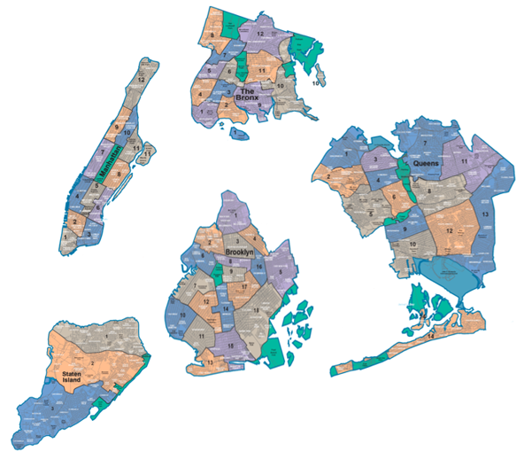
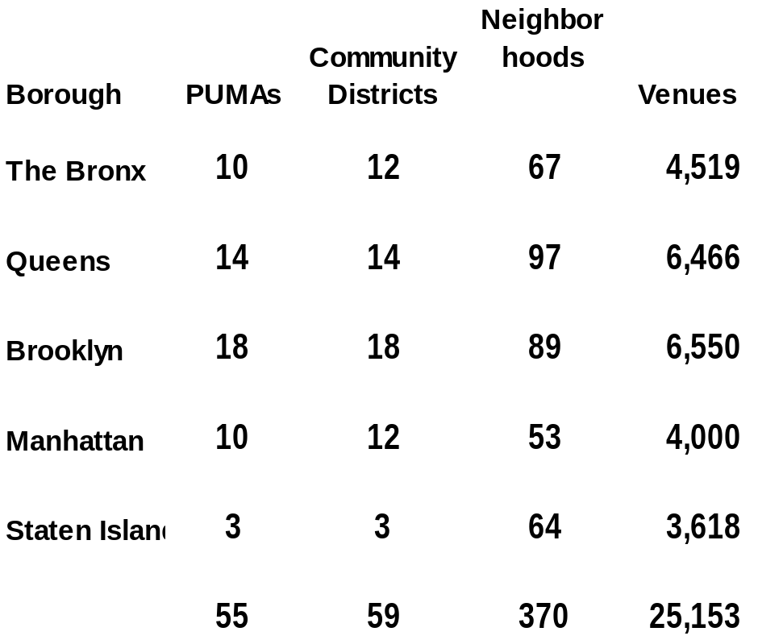
Data Architecture
The Data Architecture allows data attributes to be combined accurately
U.S. Census Bureau Community Survey data is organized by Public Use Micro-data Areas (PUMA)
PUMA geographic areas correspond exactly with NYC Community Districts
NYC Community districts are comprised of distinct neighborhoods
Four Square trending venue data is conveniently organized by city neighborhood
New York City Boroughs and component Community Districts
Data Structure for Analysis

Slide 13
Methodology and Approach
Social well-being and psychological health depend upon community.
It is no coincidence that the 'helping professions' became a major industry in the United States as suburban planning helped destroy local public life and the community support it once lent.“
- Ray Oldenburg

Slide 14
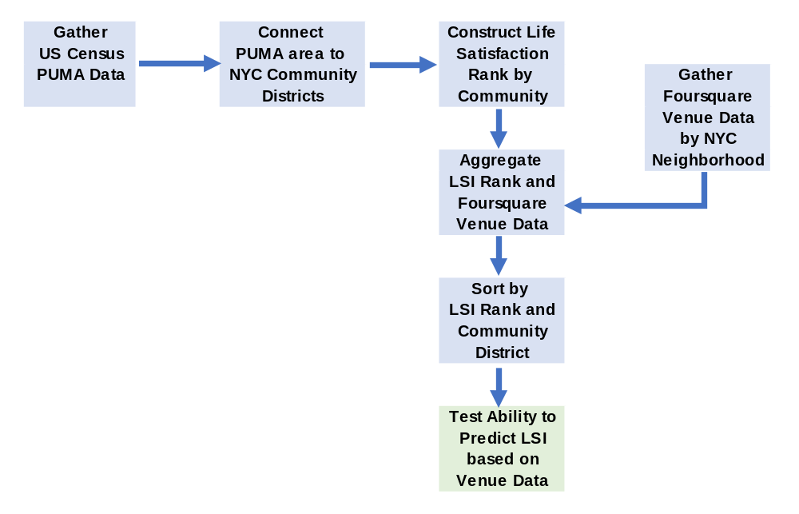
Methodology
To gain insights into how potential Third Place venues might correlate to Communities with different Life Satisfaction indicators the following process was followed;
Using cluster analysis methods, the Life Satisfaction indicator data was grouped and used to rank NYC Community Districts from Low to High for apparent Life Satisfaction.
The LSI data and Foursquare Trending Venue data was merged for each NYC Community District.
Machine Learning algorithms were used to determine if each Community District’s assigned LSI Rank could be predicted based on their Venue composition and mix.

Slide 15
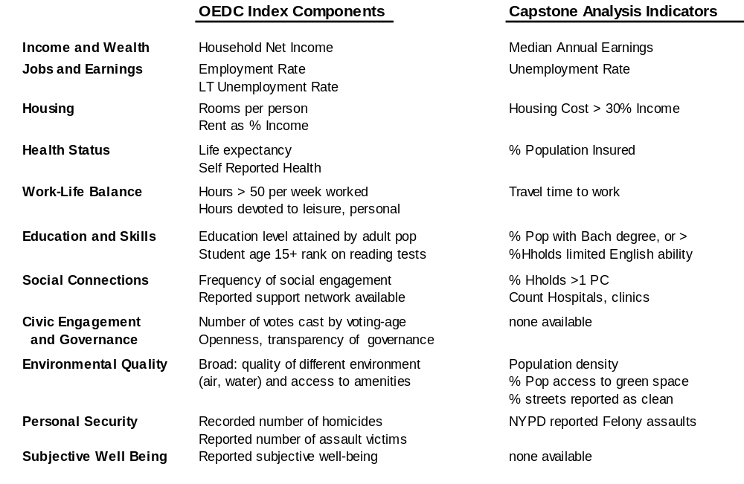
Ranking Community Life Satisfaction
A Life Satisfaction Indicator (LSI) data set was constructed on a selection of key indicators, compiled for all 59 NYC Community Districts.
The selection of attributes was based on the OECD (Organization for Economic Co-operation and Development) Better Life Index components. The OECD Index is calculated at a national level bi-annually, and is widely reported and referenced. (The LSI attributes were not weighted based on OECD observation that importance of metrics varies widely by age, gender, economic level, and national origin).

Slide 16
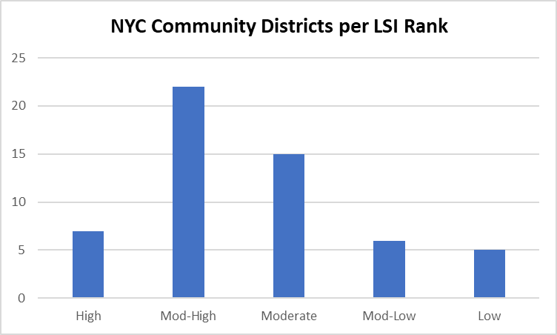
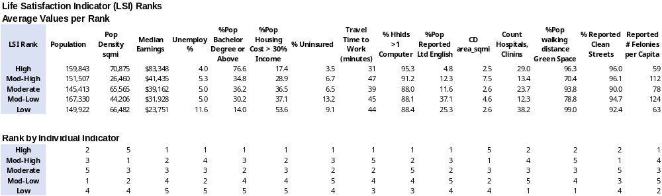
Ranking Community Life Satisfaction
Life Satisfaction Ranks (LSI) were calculated for 59 NYC Community Districts are below
The Life Satisfaction Ranks were grouped as 1 – High Satisfaction, 2 - Moderate to High, 3 – Moderate, 4 – Moderate to Low, and 5 – Low Satisfaction
The Average Indicator Values for each LSI Group are shown below

Slide 17
Analytical Methods
“The third place is remarkably similar to a good home in the psychological comfort and support that it extends...They are the heart of a community's social vitality, the grassroots of democracy, but sadly, they constitute a diminishing aspect of the American social landscape”
- Ray Oldenburg

Slide 18
Machine Learning Classification Models
Machine Learning Classification algorithms were used to determine if the mix and composition of the Trending Venue data within Ranked Community Districts was differentiated enough to allow accurate prediction of the LSI Rank.
The objective was to gain insights on how Third Place public venues might differ between various Communities with highly varied Life Satisfaction indicators, thus potentially providing valuable reference data for business and policy makers.
The Machine Learning algorithms utilized were:
K Nearest Neighbor
Log Regression
Decision Tree
Naïve Bayes
Support Vector Machine
Random Forest

Slide 19
Data Processing and Classification Models
Data Processing
The data set was normalized for each Classification model
Venues with less than 2% frequency were eliminated as outliers to control dimensionality
Train-Test-Split was used to train the models, and then applied to the test data set
Classification Models
Analysis design required multiclass classification, since the objective was to test correlation by attempting to predict 5 LSI ranks based on Venue sets with a total of 359 unique venues.
All the Python Scikit-Learn algorithms utilized support Multiclass classification (versus binary). Support Vector Machine and Log Regression are primarily binary classifiers, but can be adapted to multiclass by designating parameters of One vs One (OvO) and One vs Rest (OvR) respectively.
GridSearchCV was used to optimize parameters (after first pass with default settings)
Cross Validation (and other methods) were used to validate each model’s results
Scoring of Model Results -
Model results were evaluated on the basis of Jaccard and F1 Scores.
Confusion Matrix’s were used to evaluate misclassification error types
Log Loss was also calculated for the SVM model
Other model specifications are detailed in the Project code notebook

Slide 20
Analysis and Results
"In the absence of informal public life, living becomes more expensive.
Where the means and facilities for relaxation and leisure are not publicly shared, they become the objects of private ownership and consumption.“
- Ray Oldenburg

Slide 21
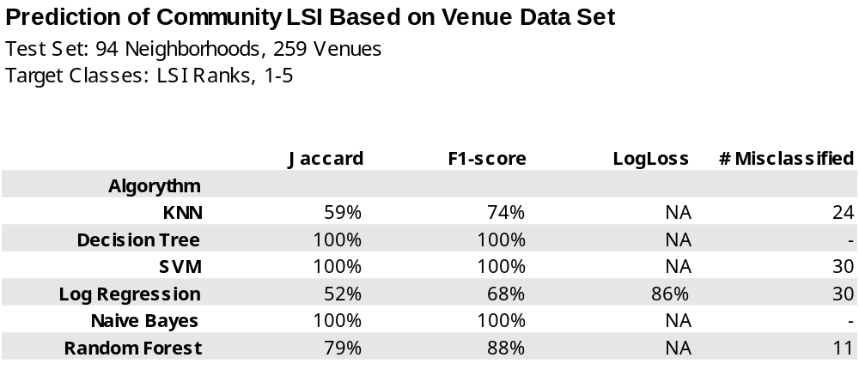
Analysis Results and Evaluation
Results -
The analysis results indicated that Public Venue data can be used to predict Life Satisfaction Ranks of NYC Communities with a relatively high degree of accuracy. Classification Model scores were:
Evaluation –
The ability to predict Community LSI Ranks based on Public Venue data indicates that Community Venue sets are differentiated between High and Low Life Satisfaction Ranked Communities (enough differentiation for prediction of LSI Rank)
Potential differentiating attributes are explored and described on following pages.

Slide 22
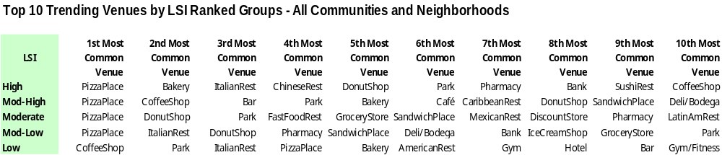
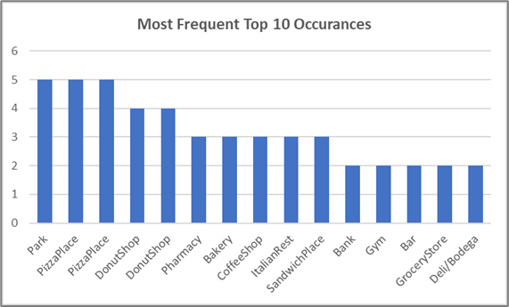
Additional Results Evaluation
Observations on the Top Venues by LSI Rank:
Across all Communities, only 2 Venues were in the Top 10 for all 5 Ranked Groups:
Pizza places, and Parks each appeared in all 5 groups
Only 1 Venue was in Top 10 Venues for 4 of 5 LSI Groups:
Donut Shops
Of all 50 Top 10 Trending Venues, 32 were Retail Food related and distributed across all LSI Groups:
Restaurants, Bakeries, etc.
Bakeries, Coffee Shops, Sandwich Places, and Italian
Restaurants each appeared in 3 groups
Of the 50 Top 10 Trending Venues, 13 were non-Retail food Related

Slide 23
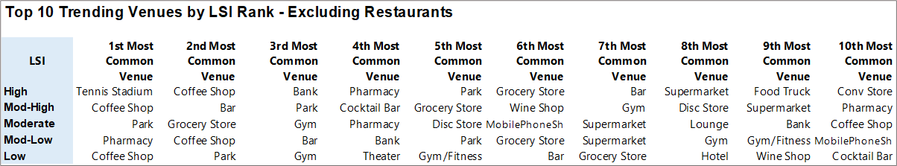
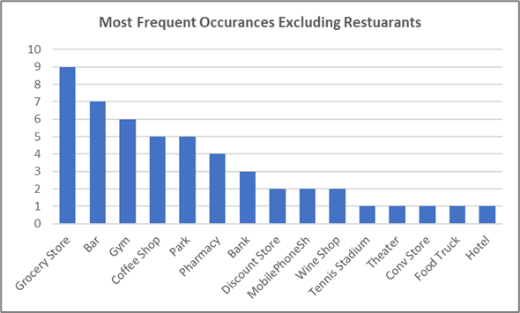
Additional Results Evaluation
Observations on Top Venues Excluding Restaurants, by LSI Rank:
Of the 50 Top 10 Trending Venues excluding Restaurants, 4 venues appeared in all 5 LSI Groups at least once:
Grocery/Supermarket – 9 appearances, Bars – 7 appearances, Coffee Shops and Parks – 5 each
Venues appearing in 4 of 5 LSI groups:
Gym/Fitness Centers – 6 appearances, Pharmacy – 4 appearances
4 Venues appeared only within the High Satisfaction LSI Group:
Tennis stadium, Theater, Convenience Store, and Food truck

Slide 24
Conclusions
“Providing the foundation for a functioning democracy, these spaces promote social equity by leveling the status of guests, providing a setting for grassroots politics, creating habits of public association, and offering psychological support to individuals and communities.”
- Ray Oldenburg

Slide 25
Conclusions
Initial analysis using ML classification models indicates that the composition of public venues in NYC are differentiated between Communities exhibiting High, Moderate, or Low ranges of other Life Satisfaction Indicators. The differentiation is to a degree that allows relatively accurate prediction of the average range of Life Satisfaction Indicators based on venue data.
No significant number of unique venue types were noted, the differentiation is appears to be driven largely by mix and differing frequency of occurrence of typical venue types.
Results were on a fairly limited test set, and utilized multiclass classification. Results should be considered preliminary pending additional validation of analytical methods, and larger test sets.
Other Observations:
Recent national events serve to accentuate the need for continued efforts to ensure that our communities are inclusive, foster the democratic process, and provide equal opportunity for every citizen to achieve well-being and a sense of community and life satisfaction.
In theory, Third Places are inclusive and open venues. As a practical matter, further analysis is required to determine if Third Place venues should be tailored to meet differing needs of communities with different socio-economic environments.
Communities, business, governance, and policy makers all have roles to play in ensuring communities are dynamic and robust. Opportunities to develop and nurture Third Places is a valuable component of these efforts, and Foursquare data along with ML analytics are valuable tools.

Slide 26
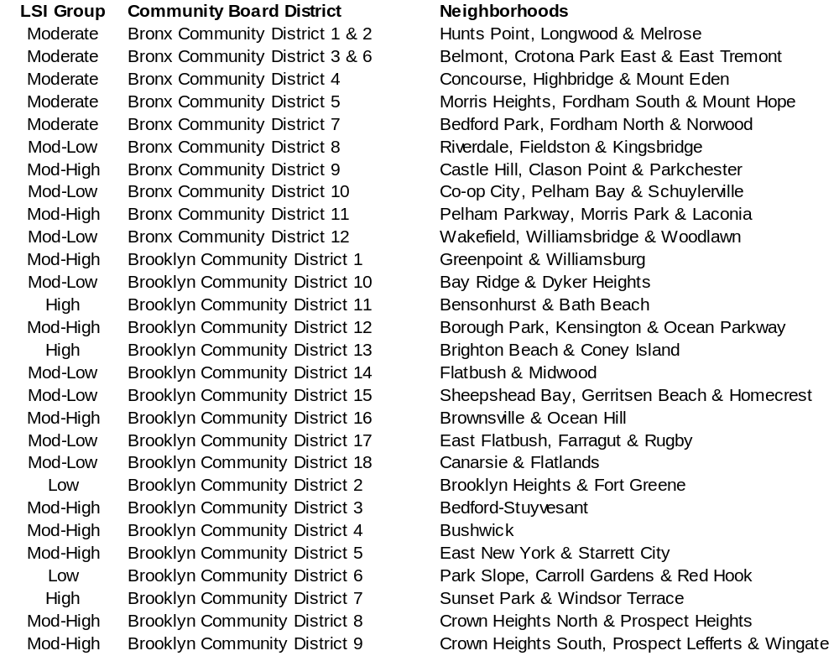
Appendix – Community Districts and Neighborhoods

Slide 27
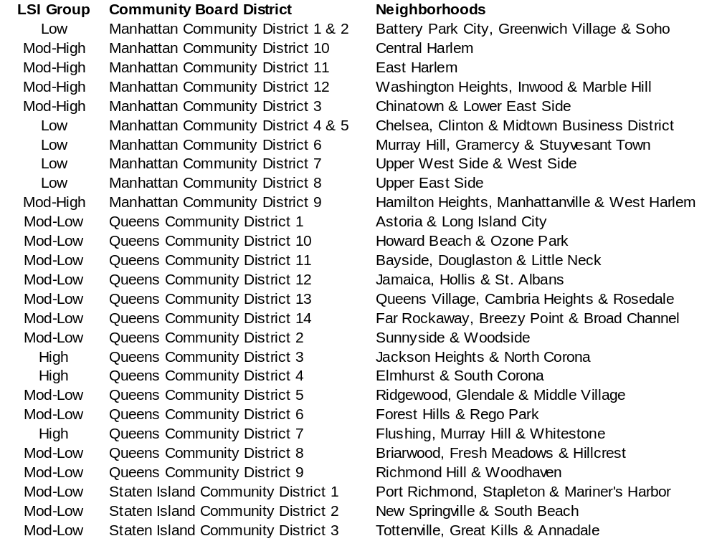
Appendix – Community Districts and Neighborhoods

